Slide 1
Erase Unconscious Bias From Your AI Datasets
Lauren Maffeo, GetApp

Slide 2


Hi! I’m Lauren
GitHub
@LaurenMaffeo
ACM interview

Slide 3
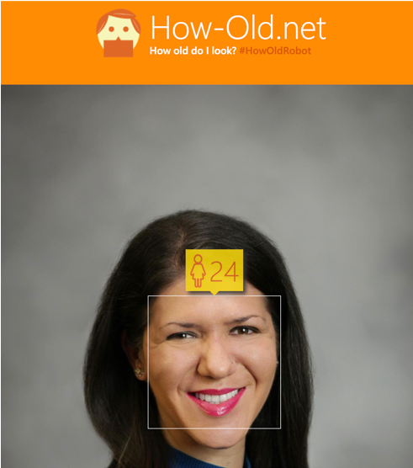
Facial Recognition Software
@LaurenMaffeo

Slide 4
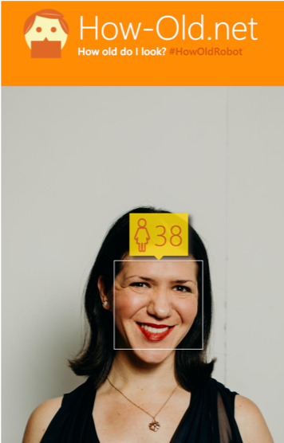
Still a Long Way to Go
@LaurenMaffeo

Slide 5
But machine learning gaffes aren’t always funny
@LaurenMaffeo
Notes:
They can have serious consequences for end users of products that are built on AI datasets.

Slide 6
Machine Bias Can Hurt Users
COMPAS
ML algorithm that predicts defendants’ likelihoods of recidivism
ProPublica found that it has made biased predictions based on race
@LaurenMaffeo

Slide 7
Machine Bias Can Hurt Users
COMPAS
2x more likely to predict black defendants as high risk…
…and 2x more likely to predict white defendants as low risk
@LaurenMaffeo
Notes:
But there was a big problem:

Slide 8

Both predictions were incorrect
@LaurenMaffeo
Notes:
This isn't a "What if?" scenario:
COMPAS has been used by judges in over 12 U.S. states to confirm prison sentences, including the lengths of those sentences and whether defendants were released on parole.
Based partially on COMPAS's recommendation, a Wisconsin judge denied probation to a man named Eric Loomis.
Instead, the judge gave Loomis a six-year prison sentence for driving a car that had been used in a recent shooting.

Slide 9
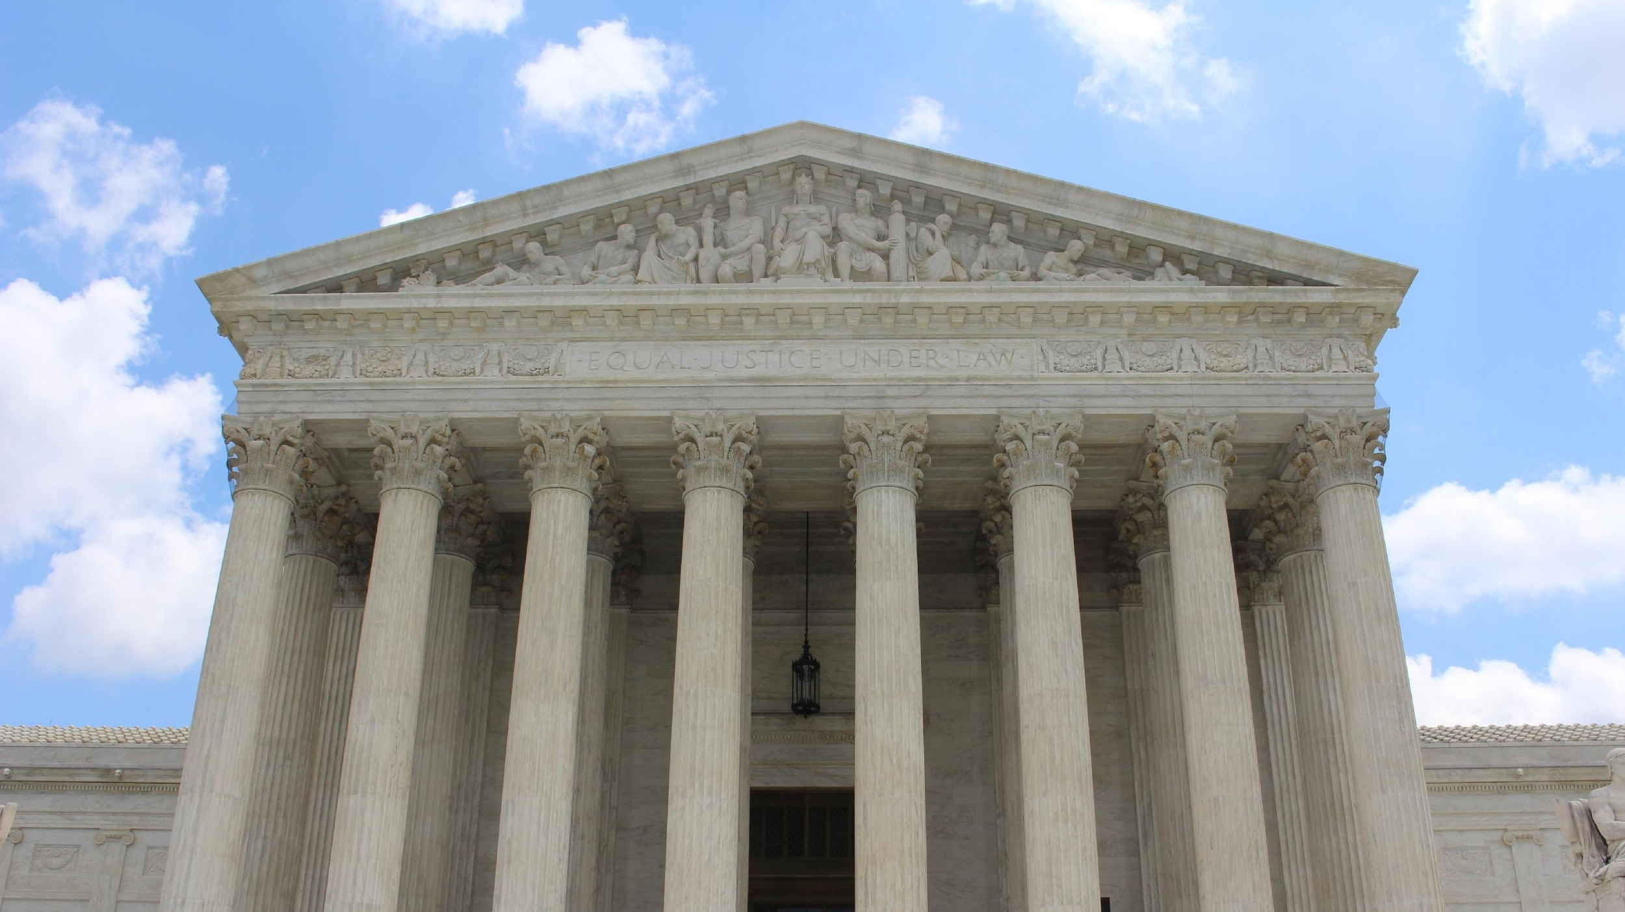
Algorithms are not unbiased
@LaurenMaffeo
Notes:
But when Loomis took his case to the Supreme Court, the justices refused to give it a hearing.
This choice signaled that most Supreme Court justices condoned the algorithm's use without knowing how it reached (often incorrect) conclusions.
This sets a dangerous legal precedent, especially as confusion about how AI works shows no signs of slowing down.

Slide 10
“Said simply — machine bias is programming that assumes the prejudice of its creators or data.”
- Nicole Shadowen
@LaurenMaffeo
Notes:
Did someone do this on purpose? Probably not.
It’s more likely that this was an unconscious mistake – the COMPAS algorithm probably didn’t get enough training to recognize diverse kinds of facial variables, including skin tone.
It’s also possible that the algorithm drew from historical data about rates of arrests between people who are black vs. people who are white and incorrectly correlated skin tone with recidivism.
We don’t know for sure, because a big risk with algorithms is that we often don’t know how they make decisions. But we can infer based on these flawed results that machines have their own biases, just like people.

Slide 11
We’ll Cover:
What machine bias is
Why it's dangerous for end users
The root cause of machine bias
How to add bias testing to product development lifecycles
Notes:
So this is a problem – and it’s a big one – but we’ll start solving it by answering four questions today.

Slide 12
What’s Machine Bias?
@LaurenMaffeo
Notes:
We already shared what machine bias is, but it’s worth unpacking that a bit more.
We all have bias, whether we know it or not.
Some say bias is what makes us human.
And they point to that bias as a reason why machines should make decisions.
Since machines don’t get tired, cranky, or irrational, the thought process says that outsourcing big decisions to them will yield more objective results.

Slide 13
Machine Bias Is:
Direct
Models predict based on sensitive/prohibited attributes
e.g. Race, religion, gender, sexual orientation
@LaurenMaffeo
Notes:
But as we all know, that’s not the case. Machines have their own biases like the rest of us.
And they manifest themselves in two distinct ways. The first is direct bias.
But believe it or not, this isn't the biggest risk in machine bias.

Slide 14
Machine Bias Is:
Indirect
Non-sensitive attributes correlating w/ sensitive attributes
e.g. the COMPAS algorithm’s predictions correlating with race
@LaurenMaffeo
Notes:
Indirect bias is harder to detect. It’s a byproduct of non-sensitive attributes correlated with sensitive attributes.
This is why the COMPAS algorithm’s predictions correlated with race.
The outcomes for one group are compared with that of another, and if the difference exceeds some agreed-upon threshold, the model is considered unacceptably biased.
So, if the difference in incarceration rates varied more than some percentage between prisoners of different ethnicities, we can infer that the algorithm is biased.

Slide 15
Machine Bias Is:
Dependent on two factors:
Priorities set by the algorithms’ designers
Which methods of fairness were accounted for
@LaurenMaffeo

Slide 16
Machine Bias Is:
Based on measures of fairness
Defines how to treat all participants in a system w/ equal respect
Wide range of possible measures, often w/ negative correlations
@LaurenMaffeo

Slide 17
Machine Bias Is:
Based on measures of fairness
As fairness increases by one measure, it decreases by another
This leads to trade-offs and competing priorities
@LaurenMaffeo

Slide 18
Measures of Fairness
Designers must decide:
Should 10 innocent people go to jail to make sure 1 guilty person isn’t released?
Or
@LaurenMaffeo
Notes:
So let’s go back to the criminal justice example.
In this case, the algorithm’s designers must decide which trade-offs to make and which results are the most fair:

Slide 19
Measures of Fairness
Designers must decide:
Should 10 guilty people be released to keep 1 innocent person out of jail?
@LaurenMaffeo
Notes:
Regardless of which choice designers make, their product’s users will feel the impact of their decision.

Slide 20
Why is machine bias dangerous?
@LaurenMaffeo
Notes:
And that leads us to our second question – why is machine bias dangerous?
There are several answers.

Slide 21
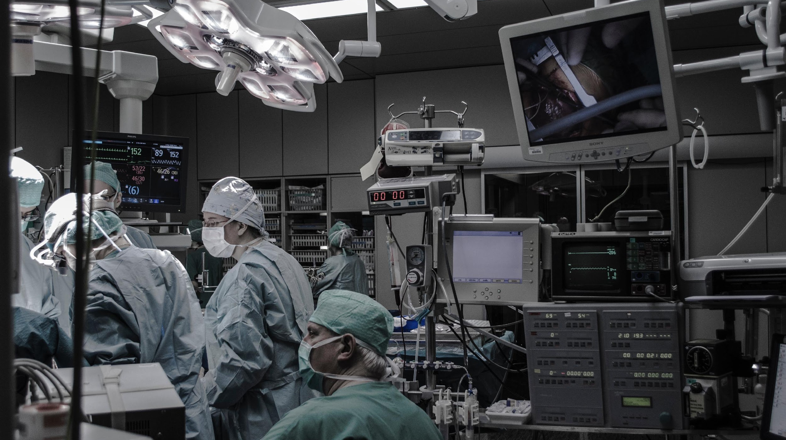
It Reinforces Human Bias
@LaurenMaffeo
Notes:
The first is that machine bias reinforces human bias.
Machines are like toddlers – they only learn from the data they’re given.
So if machines are fed data that reflects its creators’ unconscious bias, the machines themselves will reflect that bias.
This isn’t new – St. George’s Medial School in London used an algorithm in the 80s to take a first look at applicants.
It analyzed admissions records to find characteristics of successful candidates.
Then it was adjusted until its decisions matched the characteristics that the admissions team wanted to see.

Slide 22
St. George’s Medical School’s HR Algorithm
4 years later, 2 doctors realized it was biased
The algorithm rejected female and non-European names
Up to 60 applicants each year were denied interviews
@LaurenMaffeo

Slide 23
It Doesn’t Account for Context
Algorithms learn from the data they’re trained on
They don’t understand nuances like regulation changes
They also don’t know if their data is biased or homogenous
This increases the risk that they’ll reinforce early biases
@LaurenMaffeo

Slide 24

Case Story: Redlining in Portland
Notes:
One example of this is redlining.
From 1859 through 1990, people of color were banned from buying property in Portland neighborhoods.
Even though it’s illegal now, we have more than a century’s worth of real estate data that was based on a practice that’s now illegal.
As a result, any predictive models trained on this dataset are at risk of perpetuating bias.
That bias can impact who gets approved to buy homes, and where those homes are located.

Slide 25

It Puts Users’ Lives at Risk
Users of AI-powered systems put our trust into their designers and engineers
If those teams are too homogenous, they won’t build for diverse user needs
@LaurenMaffeo

Slide 26
It Puts Users’ Lives at Risk
In the 60s, crash test dummies were modeled after the average male
Today, female drivers are 47% more likely to be injured in a car crash
@LaurenMaffeo

Slide 27

@LaurenMaffeo
Notes:
Now, consider what would happen if the speech recognition software in an autonomous car can’t recognize different types of voices because it was trained on a narrow set of speech patterns.

Slide 28
“If these systems don’t recognize people of every race as human, there will be serious safety implications.”
- Dr. Carol Reiley
@LaurenMaffeo

Slide 29
What’s the Root Cause of Machine Bias?
@LaurenMaffeo

Slide 30

Black box algorithms
@LaurenMaffeo
Notes:
A big cause of this problem is black box algorithms.
It’s hard for us to know if an algorithm’s results are truly fair.
This is hard even for the algorithm’s creators – machines often behave differently in deployment than they did in production.
The result is that in extreme cases, none of us can see inside an algorithm to learn how it made decisions.

Slide 31
“the inability to discern exactly what machines are doing when they’re teaching themselves novel skills”
The Black Box Problem
Cliff Kuang, The New York Times
@LaurenMaffeo
Notes:
When we don't know how algorithms make decisions, we can’t fully trust them. In the near future, companies will have no choice but to explain their algorithms' results.
We’re already seeing legislation in Europe that would fine large tech companies for not revealing how their algorithms work. And extreme as that sounds, that’s what users want.
Research from the University of Chicago and the University of Pennsylvania showed that users have more trust in modifiable algorithms than in those built by experts.
This supports the crucial role that transparency plays in public trust of tech: People prefer algorithms when they can clearly see how those algorithms work - even if those algorithms are wrong.

Slide 32
Black Box Algorithms Are:
Considered proprietary and thus often not revealed
Built on endless neurons, each with their own biases
At risk of being manipulated by bad actors
@LaurenMaffeo
Notes:
With that said, there are reasons why creators might want to keep them private.

Slide 33
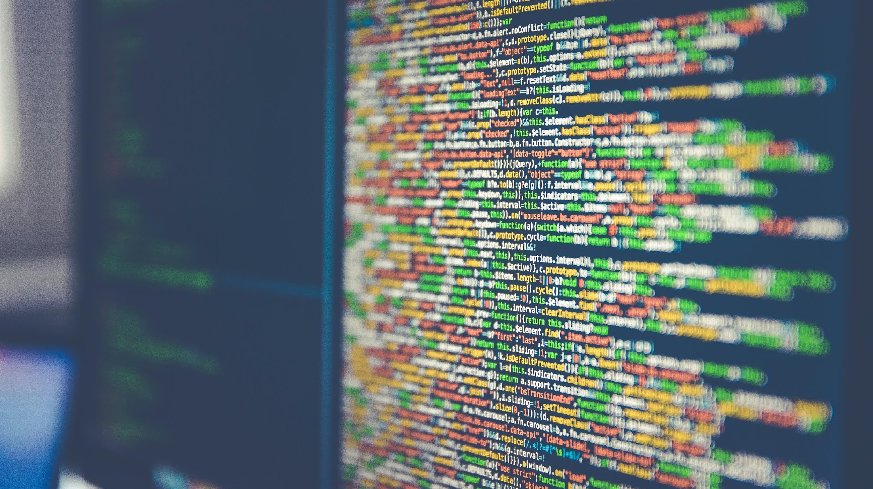
Notes:
But for transparency’s sake, they must be opened where possible.
And here's where open source frameworks like Drupal have a big advantage: Large amounts of tagged, structured content.
Frank Carey gave a presentation at DrupalCon two years ago explaining why Drupal data is ideal to train deep learning and neural networks.
These networks can make a range of big improvements to your site, from generating alt tags to image captioning.

Slide 34
LIME
An open-source Python toolkit from the University of Washington
It doesn’t try to dissect every factor influencing algorithms’ decisions
Instead, it treats every model as a black box
@LaurenMaffeo
Notes:
And luckily, there are more open source toolkits coming out these days.
LIME uses a pick-step to select a representative set of predictions or conclusions to be explained.
And then it approximates the model close to those predictions.
Then, LIME manipulates the inputs to the model and measures how predictions change.

Slide 35
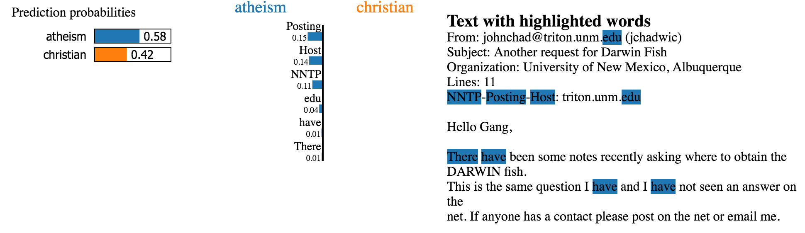
LIME Classifier
@LaurenMaffeo
Notes:
So here’s an example of a LIME classifier from text classification.
They took 2 classes – Atheism and Christian – that are tougher to distinguish since they share so many words.
LIME’s researchers trained a forest with 500 trees and got a test accuracy of 92.4%.
If accuracy was your core measure of trust, you’d be able to trust this algorithm.

Slide 36
How Can I Prevent Machine Bias?
@LaurenMaffeo
Notes:
Ultimately, responsibility for algorithmic choices doesn’t start with regulation – it starts with you.
It starts with strong data, development, and product teams collaborating to make sure that the parameters are as fair as they can be.
The good news is that while bias is inevitable, it is not impossible to overcome. There are several steps you can take to boost the health of your AI datasets.

Slide 37
Document Your Priorities Upfront
Which methods of fairness will you use?
How will you prioritize them?
@LaurenMaffeo
Notes:
This requires you to answer some key questions in the product specification phase.
Sensitive attributes should be identified and declared out of bounds unless you make an explicit justification for their inclusion.
You’ll also want to include a minimum threshold of acceptance and acceptable functioning before deploying your product.
This is helpful criteria both for internal developers and choosing external vendors.

Slide 38
Train Your Data Under Fairness Constraints
Don’t just measure average acceptance & rejection across sensitive groups
Use limits to determine what is or isn’t included in your model
Express discrimination tests as restrictions & limitations on the learning process
@LaurenMaffeo
Notes:
This is tough because when you try to control or eliminate both direct and indirect bias, you'll find yourself in a Catch-22.
If you train exclusively on non-sensitive attributes, you eliminate direct discrimination but introduce or reinforce indirect bias.
If you train separate classifiers for each sensitive feature, you reintroduce direct discrimination.
Another challenge is that detection can only occur after you've trained the model.
When this occurs, the only recourse is to scrap the model and retrain it from scratch.

Slide 39
Monitor Your Datasets Throughout the Lifecycle
Developers build training sets based on data they hope models will encounter
But many don’t monitor the data their creations receive from the real world
Appoint someone to monitor the source, history, and context of the data
@LaurenMaffeo
Notes:
Bias should be reduced as much as possible while maintaining an acceptable level of accuracy, as defined in the product specification.
It’s also not uncommon for the algorithm to be updated without the model itself being revalidated.
If unacceptable biases or behaviors are detected, the model should be rolled back to an earlier state prior to the first time you saw bias.

Slide 40
Tag Your Training Data
Tagging refers to which classes are present in an image and their locations
Doing this at scale with accuracy is a huge challenge
Tagged datasets often have their own biases
@LaurenMaffeo
Notes:
The good news is that more products are coming to market so they can decrease the time and cost of tagging.
Brain Builder is a SaaS product from Neurala, based in Boston.
They use open source frameworks like TensorFlow to help users manage and annotate their training data.
Brain Builder also aims to bring diverse class examples to data sets.
This is another key step in data training.

Slide 41
Use Diverse Class Examples
Training data needs positive and negative examples of classes
If you want specific classes of objects, you need negative examples as well
This mimics the data that the algorithm will encounter in deployment
@LaurenMaffeo
Notes:
Consider the example of “homes” within a dataset.
If the algorithm contains only images of homes in North America, it won't know to recognize homes in Japan, Morocco, or other international locations.
Its concept of a “home” is thus limited.

Slide 42
Use Diverse Class Examples
10 open-sourced AI datasets (Synced)
Public datasets by industry (GitHub)
@LaurenMaffeo
Notes:
Luckily, 2018 saw a strong increase in the number of open source AI datasets.
Synced has a helpful roundup of 10 datasets—from multi-label images to semantic parsing—that were open sourced last year.

Slide 43
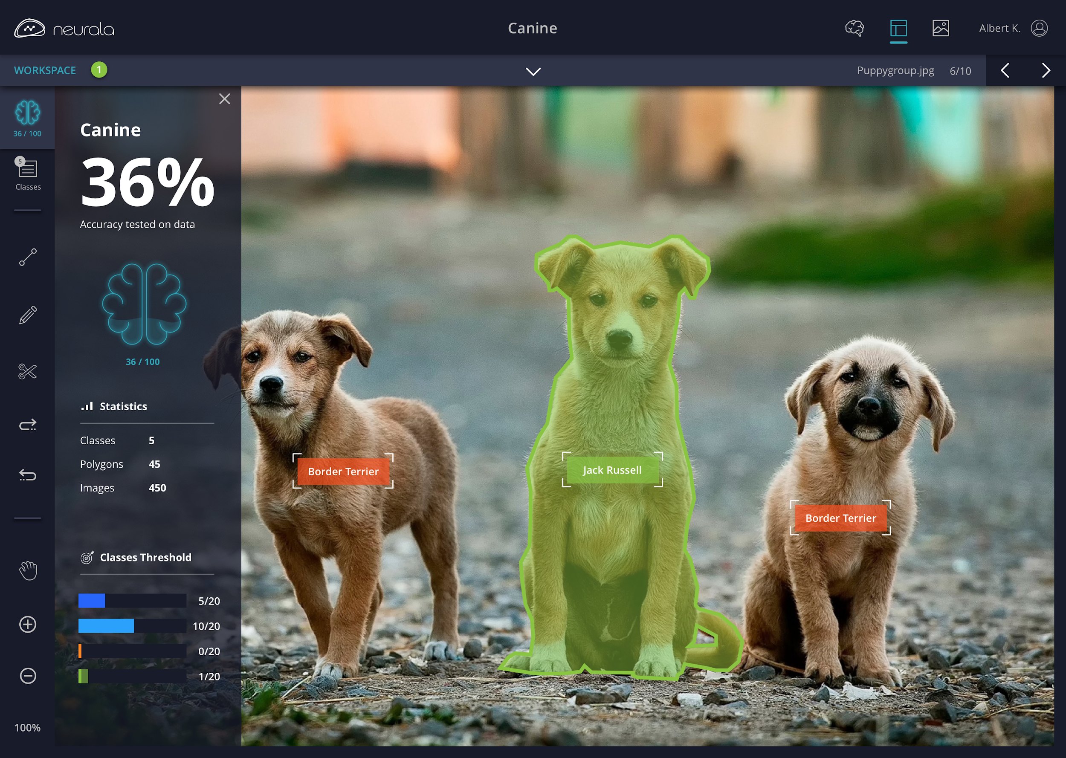

Focus on the Subject, Not the Context
A training set focused on context
A training set focused on the subject
@LaurenMaffeo
Notes:
Let’s start by looking at the training set on the left. This is an example of a biased training set.
That’s because wolves were tagged standing in snow, but the model wasn’t shown images of dogs.
So, when dogs were introduced, the model started tagging them as wolves because they were both standing in snow.
Classification errors like this mean that the model being trained was either incomplete or inaccurate.
On the right, we have a training set from Brain Builder that is focused on the subject – dogs.
Having someone monitor your data helps your team know when to retrain your model or expand your training data.

Slide 44

Ethical debt *is* technical debt
Notes:
If you leave this room remembering one thing, I want it to be this:
Ethical debt *is* technical debt.
Bias leads to poor data,
which leads to poorly trained neural networks,
which leads to a bad user experience that can be deadly in some cases.
And when bias is found, your only recourse is to scrap the model and retrain it from scratch.
The title of my talk is a bit misleading - you can't erase machine bias from AI datasets. It's unavoidable - but it's also manageable.

Slide 45
Recommended Reading
A Privacy Dustup at Microsoft Exposes Major Problems for AI
Medium
Control Bias and Eliminate Blind Spots in Machine Learning and Artificial Intelligence
Gartner
Brain Builder (free trial using your own data)
Neurala
How We Analyzed the COMPAS Recidivism Algorithm
ProPublica
LIME - Local Interpretable Model-Agnostic Explanations
University of Washington
Overcoming Algorithm Aversion
The University of Chicago and The University of Pennsylvania

Slide 46
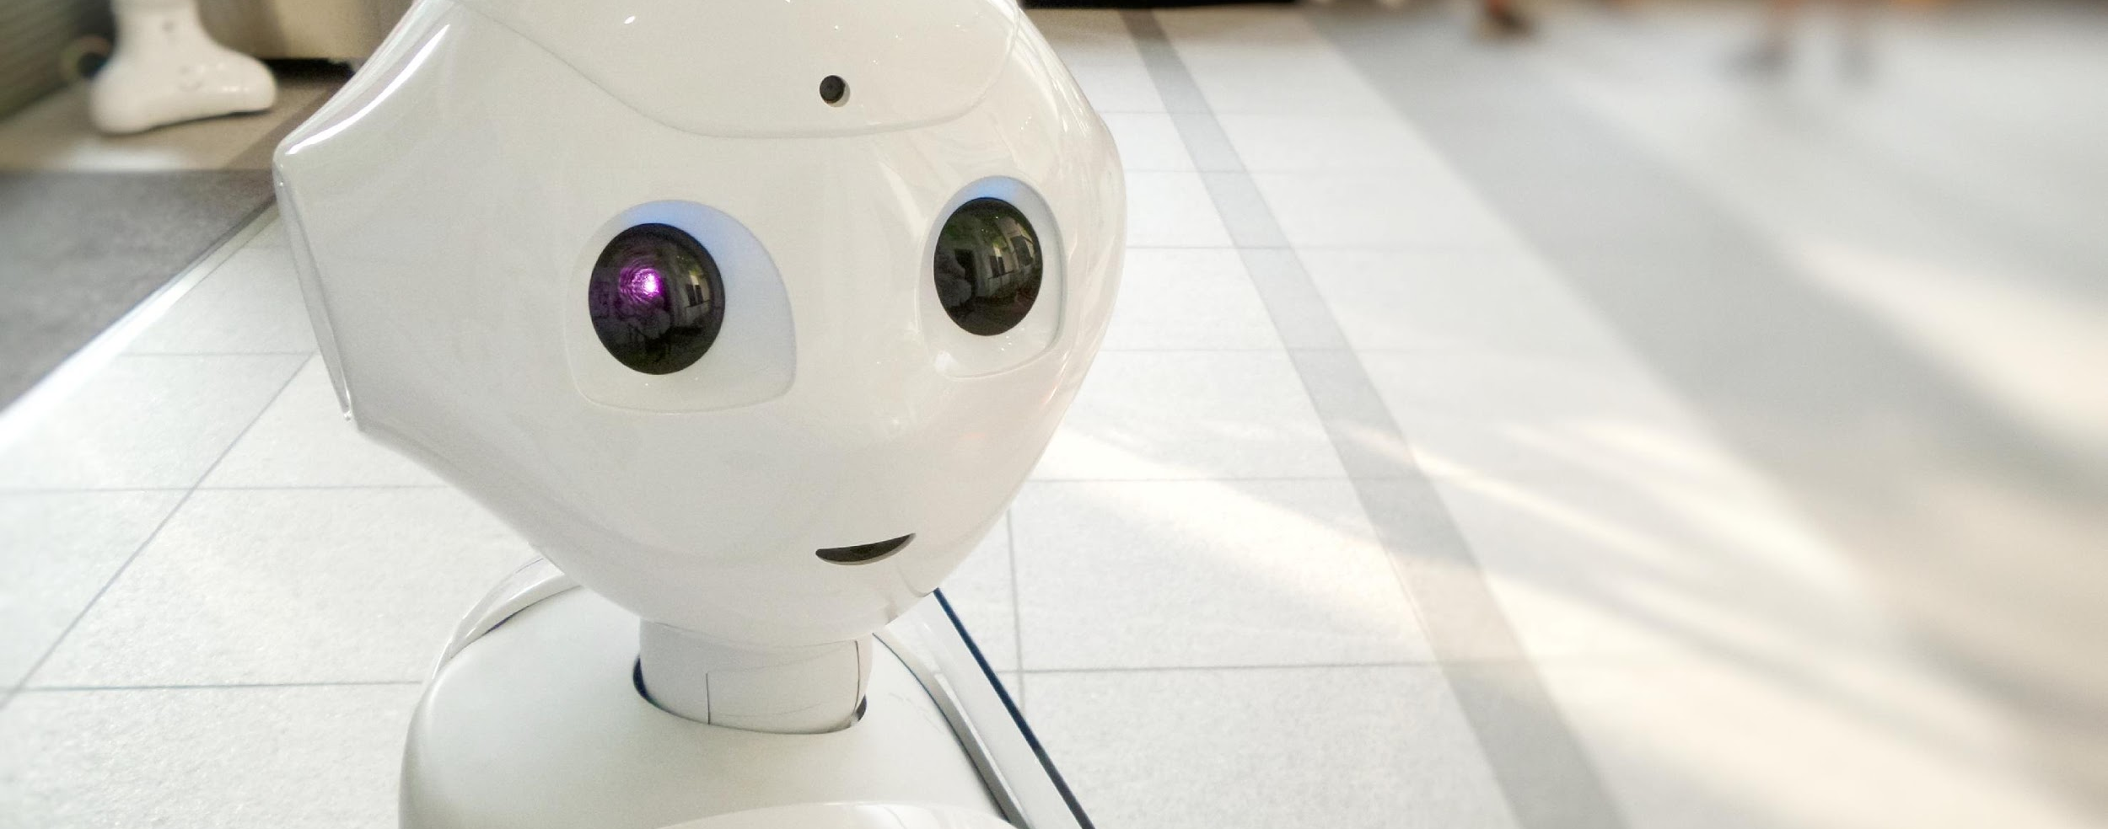
Thank you!
@LaurenMaffeo

